Slide 1


AMRUHA AHMED
15th October, 2024.
GitHub Link: https://github.com/AmruhaAhmed/IBM-Applied-Data-Science-Capstone-

Slide 2

Outline
Executive Summary
Introduction
Methodology
Results
Conclusion
Appendix

Slide 3

Executive Summary
Summary of methodologies
The following methods were applied to gain a comprehensive picture of the data available:
Data Collection
Data Wrangling
EDA
Interactive Analytical Dashboard
Predictive Analysis
Summary of all results
EDA and visualizations using dashboards helped in understanding how each parameter is affected by other and gain valuable insights
Accuracy of predicting whether the first stage of Falcon 9 rocket will land or not is 83.33%

Slide 4
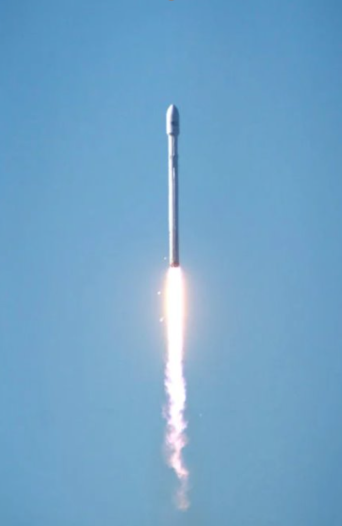
Introduction
Project background and context
Space X advertises Falcon 9 rocket launches on its website with a cost of 62 million dollars; other providers cost upward of 165 million dollars each, much of the savings is because Space X can reuse the first stage.
Problems you want to find answers
determine the price of each launch for Space Y , that is competing with SpaceX.
Gather information about SpaceX
Creating dashboards for better insights
Whether SpaceX will reuse the first stage of Falcon 9 or not using machine learning

Slide 5

Section 1

Slide 6
Methodology
Executive Summary
Data collection methodology:
Data was collected using web scraping and API's
Perform data wrangling
Data was processed using value_counts( ) and functions of descriptive statistics
Perform exploratory data analysis (EDA) using visualization and SQL
Perform interactive visual analytics using Folium and Plotly Dash
Perform predictive analysis using classification models
Models were built using Logistic Regression, KNN, SVM, Decision Tree. Grid Search was applied. Models were evaluated using accuracy, precision, recall, F1 Score and confusion matrix

Slide 7
Data Collection
How the datasets were collected?
API :https://api.spacexdata.com/v4/launches/past
Wikipedia : https://en.wikipedia.org/wiki/List_of_Falcon_9_and_Falcon_Heavy_launches

Slide 8
Data Collection – SpaceX API
The data is obtained from Space X API : https://api.spacexdata.com/v4/launches/past
GitHub URL to my .ipynb notebook containing Data Collection using Space X API Code: https://github.com/AmruhaAhmed/IBM-Applied-Data-Science-Capstone-/blob/main/data%20collection%20using%20api.ipynb
URL is used to target a specific endpoint of the API to get past launch data.
perform a get request using the requests library to obtain the launch data
Result is views using .json()
To convert JSON into pandas dataframe, json_normalize() is used

Slide 9
Data Collection - Web Scraping
Beautiful Soup package is used
The data is obtained from Wikipedia : https://en.wikipedia.org/wiki/List_of_Falcon_9_and_Falcon_Heavy_launches
GitHub URL to my .ipynb notebook containing Data Collection using Web Scraping Code:
https://github.com/AmruhaAhmed/IBM-Applied-Data-Science-Capstone-/blob/main/data%20collection%20using%20web%20scraping.ipynb
Data is parsed from tables
Data converted into pandas dataframe
Instances of falcon 1 are removed
Null values of Pyaload Mass are filled

Slide 10
Data Wrangling
Data Wrangling of the dataset involved the following steps:
Calculating the number of launches on each site
Calculating the number and instance of each orbit
Calculating the number and ocurrence of mission outcome of the orbits
Create a landing outcome label from Outcome column
Exporting the resultant dataframe into dataset_part_2.csv
GitHub Link: https://github.com/AmruhaAhmed/IBM-Applied-Data-Science-Capstone-/blob/main/data%20wrangling.ipynb
Data Analysis
Descriptive Statistics
Determining TRaining Labels

Slide 11
EDA with Data Visualization
Exploratory Data Analysis of the dataset using Pandas and Matplotlib libraries in Python involved the following tasks :
Visualize the relationship between Flight Number and Launch Site
Visualize the relationship between Payload Mass and Launch Site
Visualize the relationship between success rate of each orbit type
Visualize the relationship between FlightNumber and Orbit type
Visualize the relationship between Payload Mass and Orbit type
Visualize the launch success yearly trend
All these graphs were made using scatter plot as it easily helps in finding correlation among two variables. Hues can be added accordingly
GitHub Link: https://github.com/AmruhaAhmed/IBM-Applied-Data-Science-Capstone-/blob/main/eda%20with%20pandas%20and%20matplotlib.ipynb

Slide 12
EDA with SQL
Exploratory Data Analysis of the dataset using SQL involved the following tasks :
Installing SQL alchemy
Connecting to a database
Displaying the names of the unique launch sites in the space mission
Displaying 5 records where launch sites begin with the string 'CCA'
Displaying the total payload mass carried by boosters launched by NASA (CRS)
Displaying average payload mass carried by booster version F9 v1.1
Listing the date when the first succesful landing outcome in ground pad was acheived.
GitHub Link: https://github.com/AmruhaAhmed/IBM-Applied-Data-Science-Capstone-/blob/main/eda%20with%20sql.ipynb

Slide 13
EDA with SQL
Listing the names of the boosters which have success in drone ship and have payload mass greater than 4000 but less than 6000
Listing the total number of successful and failure mission outcomes
Listing the names of the booster_versions which have carried the maximum payload mass.
Listing the records which will display the month names, failure landing_outcomes in drone ship ,booster versions, launch_site for the months in year 2015.
Ranking the count of landing outcomes (such as Failure (drone ship) or Success (ground pad)) between the date 2010-06-04 and 2017-03-20, in descending order.
GitHub Link: https://github.com/AmruhaAhmed/IBM-Applied-Data-Science-Capstone-/blob/main/eda%20with%20sql.ipynb

Slide 14
Build an Interactive Map with Folium
Markers and Circles:
Marker and Circle are used to indicate the NASA Johnson Space Center at Houston, Texas.
They are also used to indicate the Launch Sites
If a launch was successful , then we use a green marker and if a launch was failed, we use a red marker
Procedure:
create a folium `Map` object,
Create and add `folium.Circle` and `folium.Marker` for each launch site on the site map
Create a new column in `spacex_df` dataframe called `marker_color` to store the marker colors based on the `class` value
Mark the success/failed launches for each site on the map
For each launch result in `spacex_df` data frame, add a `folium.Marker` to `marker_cluster`
Calculate the distances between a launch site to its proximities
GitHub Link: https://github.com/AmruhaAhmed/IBM-Applied-Data-Science-Capstone-/blob/main/interactive%20visualizations%20using%20folium.ipynb

Slide 15
Build a Dashboard with Plotly Dash
Summary of Graphs Used
A pie chart to depict the Lauch sites and a scatter plot to show the Correlation between Payload and Success that are made interactive using Payload slider and selection of Launch Sites.
Procedure:
Reading the airline data into pandas dataframe
Creating a dash application
Creating an app layout
Adding a dropdown list to enable Launch Site selection
Adding a callback function for `site-dropdown` as input, `success-pie-chart` as output. And a function decorator to specify function input and output
GitHub Link: https://github.com/AmruhaAhmed/IBM-Applied-Data-Science-Capstone-/blob/main/interactive%20dashboard%20using%20dash.py

Slide 16
Standardizing independent variables
Predictive Analysis (Classification)
4 different classification models were built :
Decision Tree Classifier
Support vEctor Machine
K Neaest Neighbors
Logistic Regression
Model is evaluated using :
Accuracy
Precision
recall
f1 score
GitHub Link:https://github.com/AmruhaAhmed/IBM-Applied-Data-Science-Capstone-/blob/main/predictive%20analysis(classification).ipynb
Dividing dataset into trainign and testing (test size=20%)
Model Building
Hyperparamter Tuning with Grid Search CV (cv=10)
Model Evaluation

Slide 17
Model Evaluation
Model | accuracy | precision | recall | F1 score
Logistic Regression | 0.8333333333333 | 0.8 | 1 | 0.88888888
Support Vector Machine | 0.83333333333333 | 0.8 | 1 | 0.88888888
Decision Tree | 0.72222222222222 | 0.81818 | 0.75 | 0.7826086
K Nearest Neighbors | 0.833333333333 | 0.8 | 1 | 0.88888888

Slide 18
Results
Exploratory data analysis results
Interactive analytics demo in screenshots
Predictive analysis results

Slide 19

Section 2

Slide 20
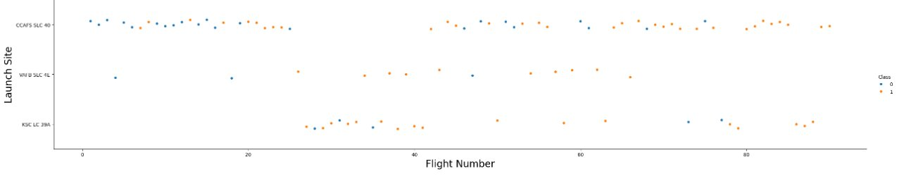
Flight Number vs. Launch Site
Results of Task 1: Visualize the relationship between Flight Number and Launch Site
Insights Gathered : Flight Numbers are higher in CCAFS SLC 40 , with most of them being successful

Slide 21
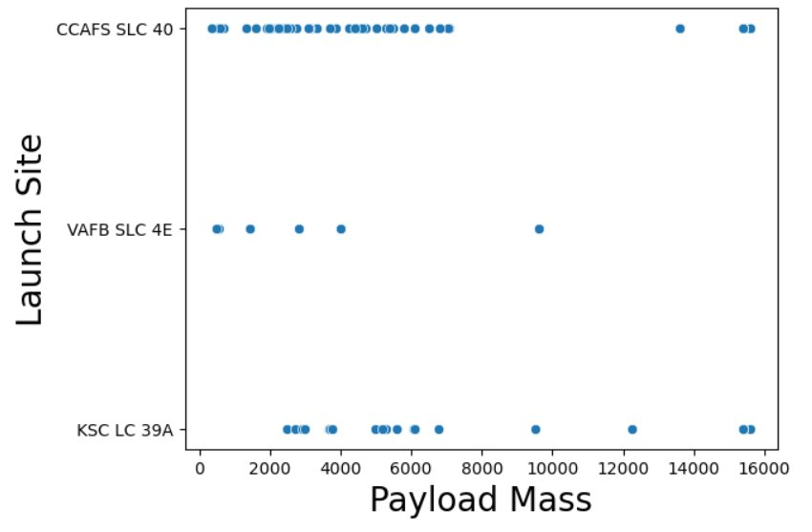
Payload vs. Launch Site
Results of Task 2: Visualize the relationship between Payload Mass and Launch Site
Insights Gathered : CCFAS SLC 40 AND KSC LC 39 A have the highest Payload Masses recorded

Slide 22
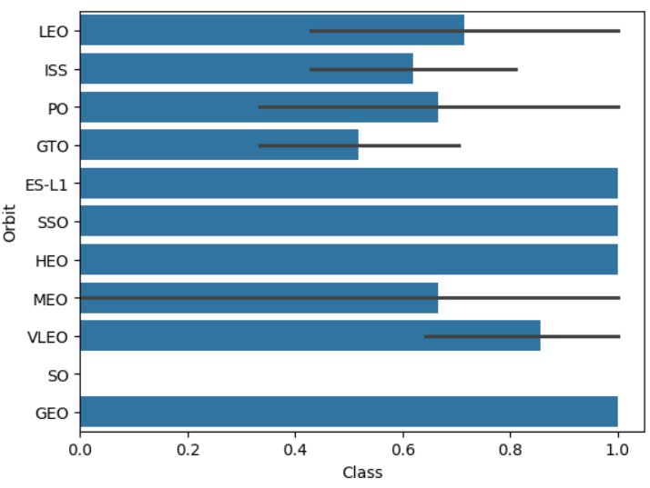
Success Rate vs. Orbit Type
Results of Task 3: Visualize the relationship between success rate of each orbit type
Insights Gathered : ES –L1 , SSO,HEO and GEO have the highest success rate whereas SO has the lowest success rate

Slide 23
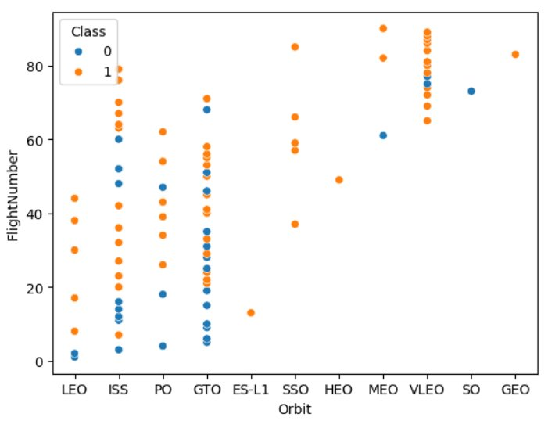
Flight Number vs. Orbit Type
Results of Task 4 : Visualize the relationship between FlightNumber and Orbit type
Insights Gathered : In LEO orbit, higher number of flights has higher success rate. IN SSO, each flight has high success rate but there is no clear pattern fr the rest of the orbits

Slide 24
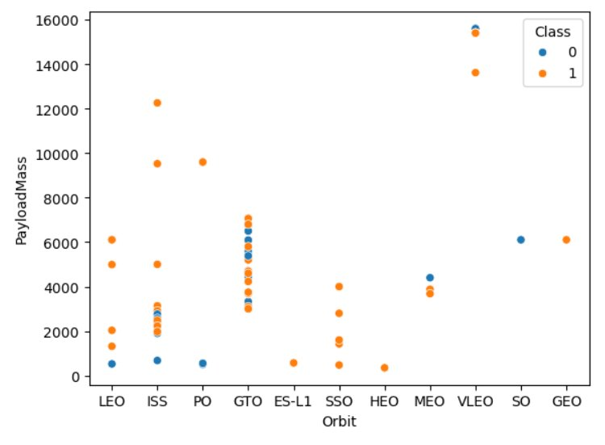
Payload vs. Orbit Type
Results of Task 5: Visualize the relationship between Payload Mass and Orbit type
Insights Gathered : for orbit types LEO, SSO, higher payload mass guarentees success rate

Slide 25
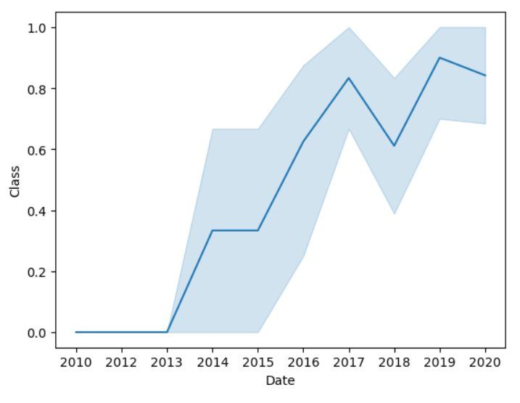
Launch Success Yearly Trend
Results of Task 6: Visualize the launch success yearly trend
Insights Gathered : there is a steady increase in success rate form 2010 to 2020 , with a slight dip in 2018

Slide 26
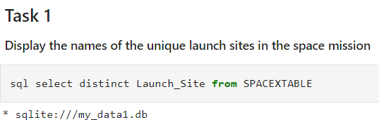
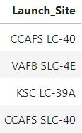
All Launch Site Names
Results of Task 1:Display the names of the unique launch sites in the space mission
Query Result

Slide 27
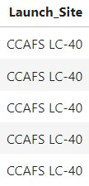
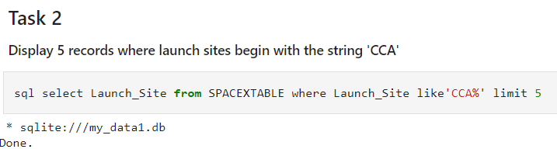
Launch Site Names Begin with 'CCA'
Results of Task 2:Display 5 records where launch sites begin with the string 'CCA'
Query Result

Slide 28
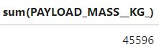
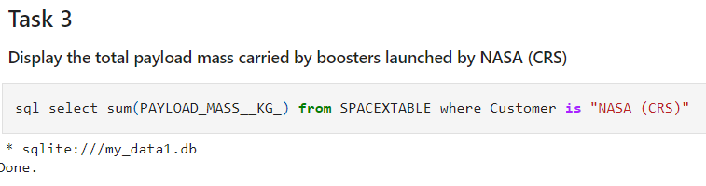
Total Payload Mass
Results of Task 3:Display the total payload mass carried by boosters launched by NASA (CRS)
Query Result

Slide 29
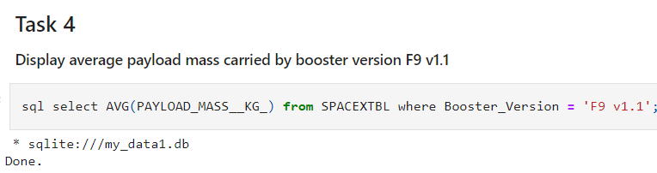
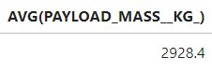
Average Payload Mass by F9 v1.1
Results of Task 4:Display average payload mass carried by booster version F9 v1.1
Query Result

Slide 30
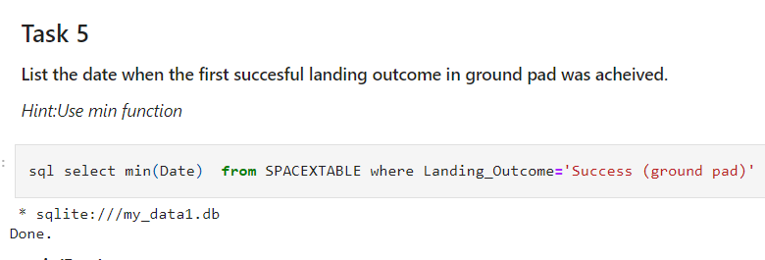
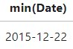
First Successful Ground Landing Date
Results of Task 5:List the date when the first succesful landing outcome in ground pad was acheived.

Slide 31
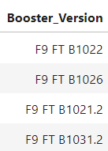
Successful Drone Ship Landing with Payload between 4000 and 6000
Results of Task 6:List the names of the boosters which have success in drone ship and have payload mass greater than 4000 but less than 6000
sql select distinct Booster_Version from SPACEXTBL where PAYLOAD_MASS__KG_ between 4000 and 6000 and Landing_Outcome = 'Success (drone ship)'

Slide 32
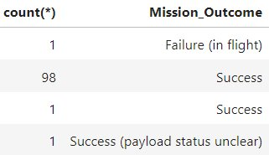
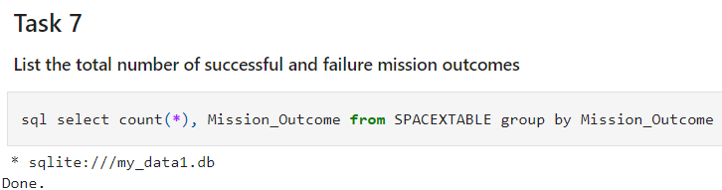
Total Number of Successful and Failure Mission Outcomes
Results of Task 7: List the total number of successful and failure mission outcomes

Slide 33
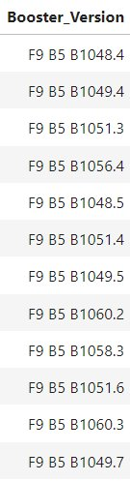
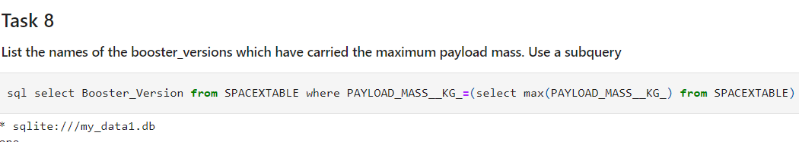
Boosters Carried Maximum Payload
Results of Task 8: List the names of the booster_versions which have carried the maximum payload mass. Use a subquery

Slide 34
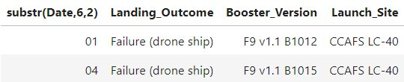
2015 Launch Records
Results of Task 9: List the records which will display the month names, failure landing_outcomes in drone ship ,booster versions, launch_site for the months in year 2015.
sql select substr(Date,6,2), Landing_Outcome, Booster_Version, Launch_Site from SPACEXTABLE where substr(Date,0,5)=='2015' and Landing_Outcome='Failure (drone ship)'

Slide 35
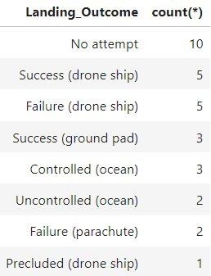
Rank Landing Outcomes Between 2010-06-04 and 2017-03-20
Results of Task 10: Rank the count of landing outcomes (such as Failure (drone ship) or Success (ground pad)) between the date 2010-06-04 and 2017-03-20, in descending order
sql select Landing_Outcome , count(*) from SPACEXTABLE where date between '2010-06-04' and '2017-03-20' group by Landing_Outcome order by count(*) desc

Slide 36

Section 3

Slide 37
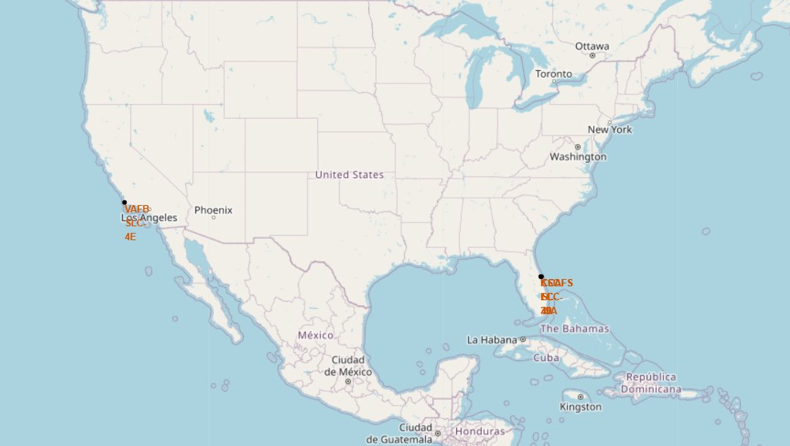
Marking Launch Sites on the Map

Slide 38
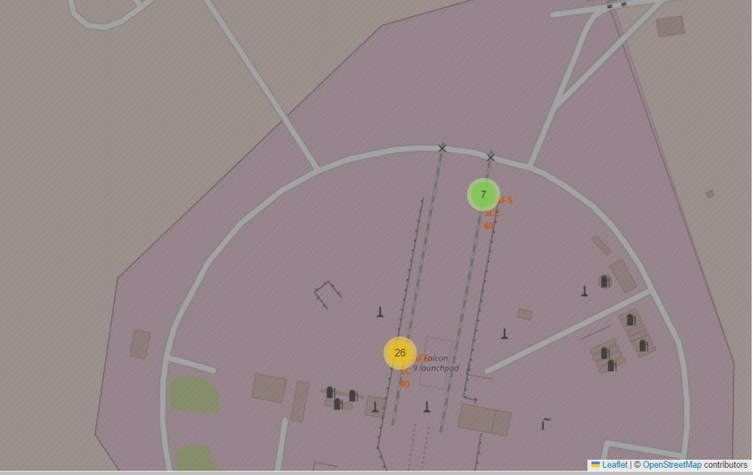
Color-labeled launch outcomes

Slide 39

Section 4

Slide 40
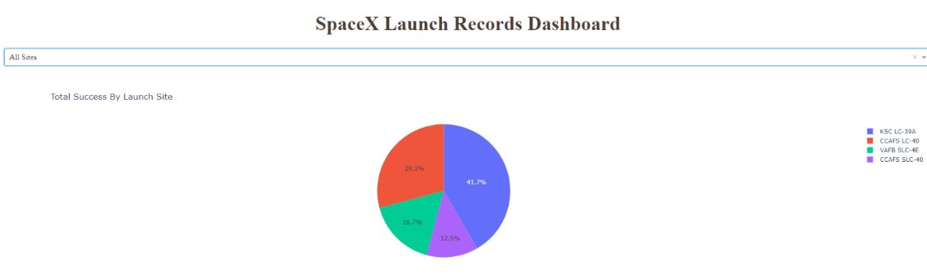
Total Success By Launch Site
KSC LC 39 A has the highest total success by launch site
CCAFS SLC 40 has the least success by launch site

Slide 41
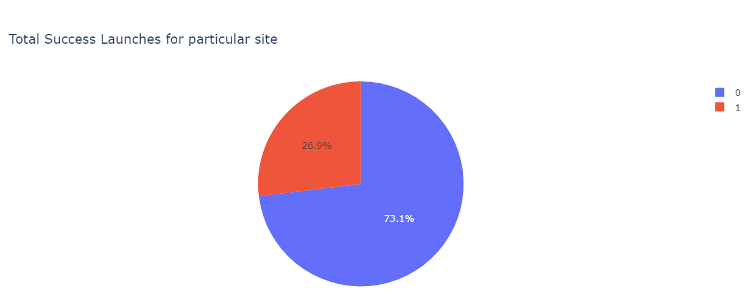
Total Success Launches for a particular site

Slide 42
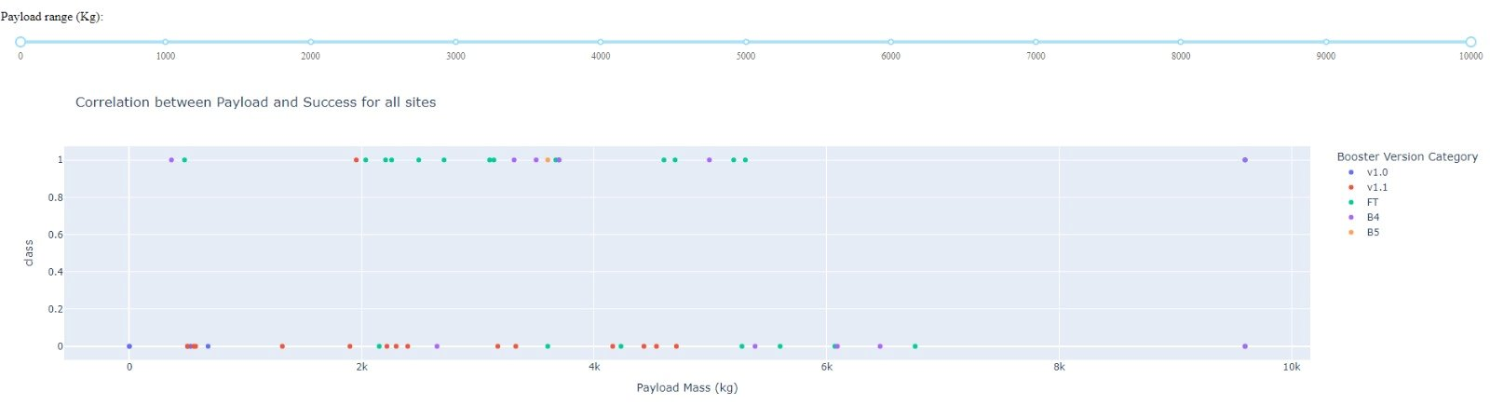
Correlation between Payload and Launch Outcome
Graph for Correlation between Payload and Success for all sites
Made interactive using the filters of payload range and Launch sites drop down
2k to 6k payload range has the highest amount of success rate
FT Booster Version has the highest amount of success rate

Slide 43

Section 5

Slide 44
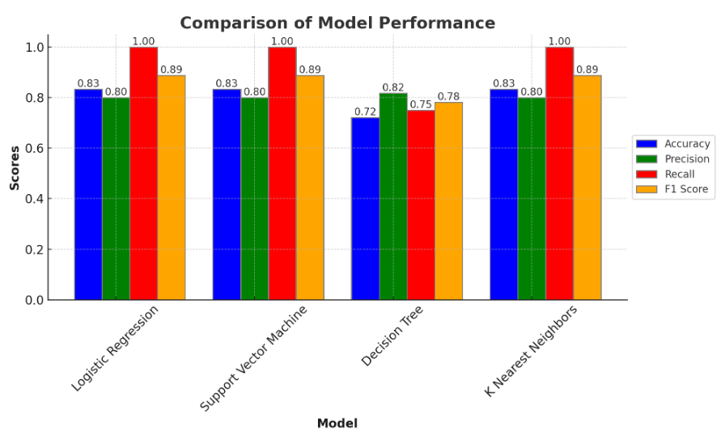
Classification Accuracy
KNN, SVM and Logistic Regression give the same accuracy of 83.33%

Slide 45
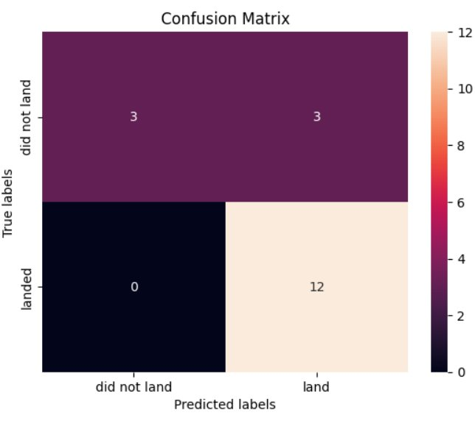
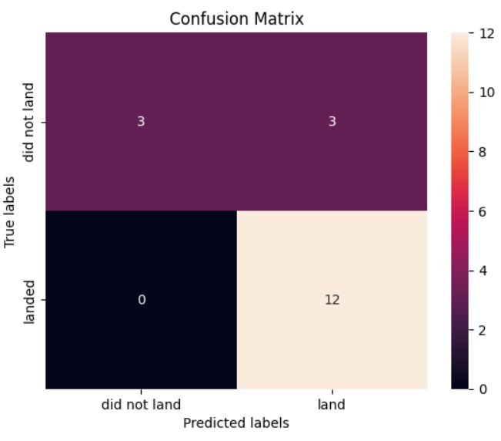
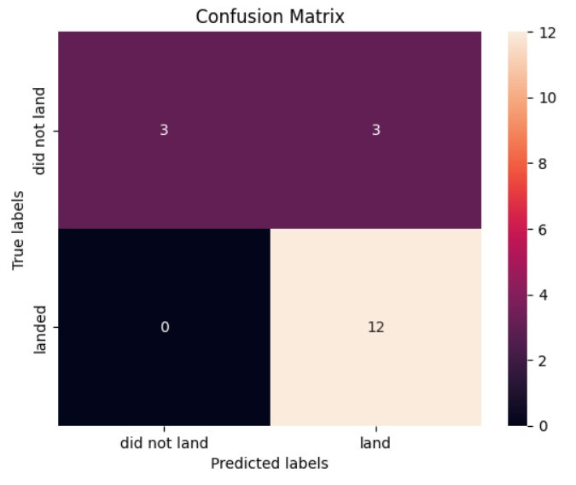
Confusion Matrix
Confusion Matrix for Logistic Regression
Confusion Matrix for SVM
Confusion Matrix for KNN

Slide 46
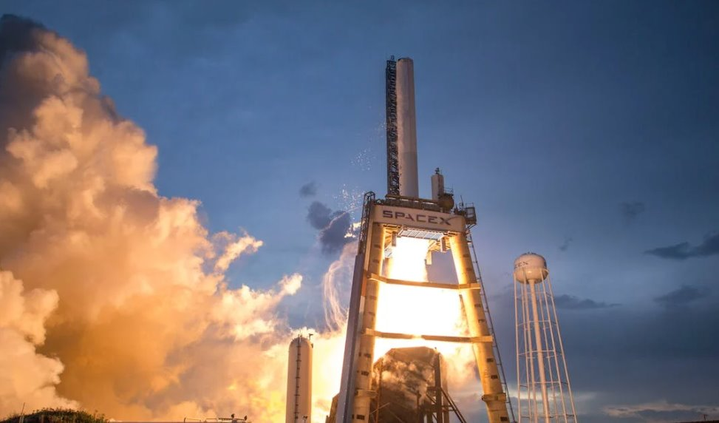
Conclusions
KNN, SVM and Logistic Regression are the best performing models
Flight Numbers are higher in CCAFS SLC 40 , with most of them being successful
CCFAS SLC 40 AND KSC LC 39 A have the highest Payload Masses recorded
KSC LC 39 A has the highest total success by launch site
CCAFS SLC 40 has the least success by launch site
2k to 6k payload range has the highest amount of success rate
FT Booster Version has the highest amount of success rate

Slide 47
Appendix
Table of Comparison for Different Models and their Best Parameters Chosen using Grid Search CV
Model | Best Parameters Chosen
Logistic Regression | 'C'= 0.01, 'penalty'='l2', 'solver'= 'lbfgs'
Support Vector Machine | 'C'= 1.0, 'gamma'= 0.03162277660168379, 'kernel'= 'sigmoid'
Decision Tree | 'criterion'='gini', 'max_depth'= 2, 'max_features'= 'sqrt', 'min_samples_leaf'= 1, 'min_samples_split'= 5, 'splitter'= 'random'
K Nearest Neighbors | 'algorithm'= 'auto', 'n_neighbors'= 10, 'p'= 1

Slide 48


